Slide 1
Project 4: Predicting Scores for NFL games
By: Alec Mintz, David Czoper, and Ben Fish
Notes:
Ben

Slide 2
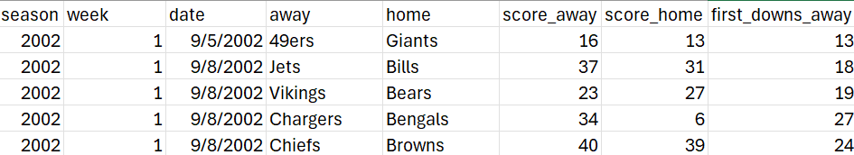
Original Data Source
https://www.kaggle.com/datasets/cviaxmiwnptr/nfl-team-stats-20022019-espn
5,930 rows
53 columns
Data on all offensive and defensive plays from 2002 - 2023
Data is collected for each weekly game throughout the regular and postseason
Notes:
Ben

Slide 3
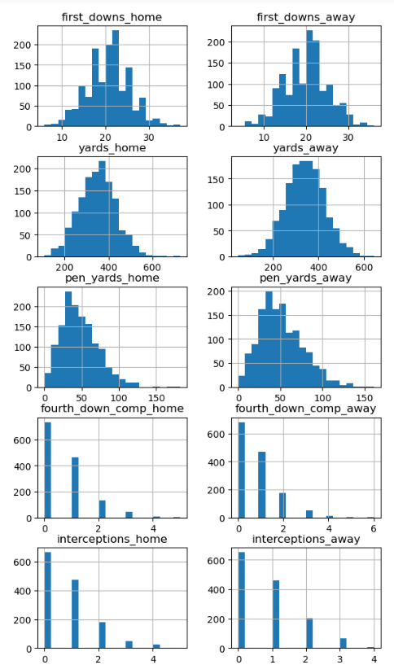
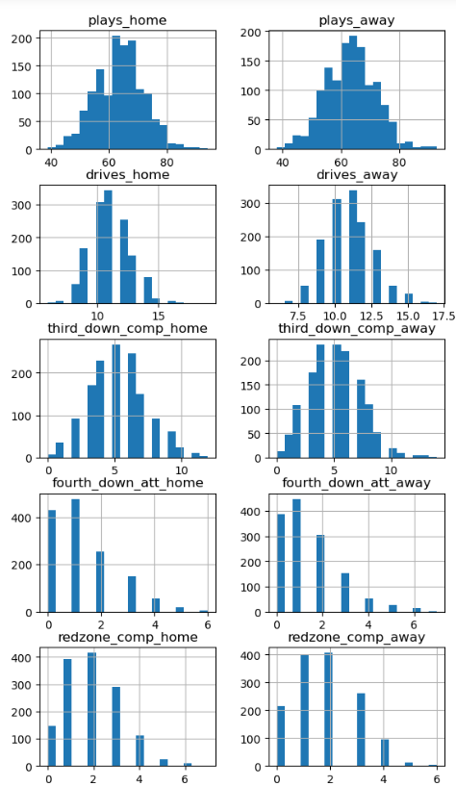
Exploratory Data Analysis
Data was filtered down to games from 2018 through last season
Certain categories were targeted as most influential on the final score of a game
Data remained consistent across home and away categories
The largest distance from the mean between home and away categories was 9 yards (home/away total yards)
Notes:
Alec

Slide 4
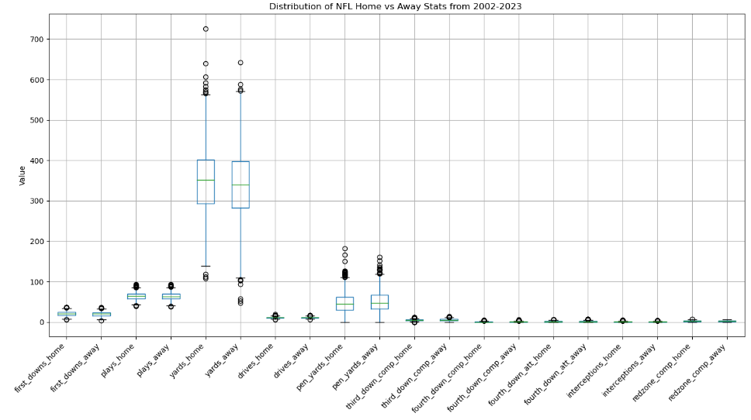
Exploratory Data Analysis
Extreme outliers are seen in the in the total yards & penalties categories
Home/away yards mean = 349.21/340.18
Home/away yards std = 82.65/85.92
Home/away penalty yards mean = 47.51/51.28
Home/away penalty yards std = 24.96/25.74
Notes:
Alec

Slide 5
Model Iterations
The features yards and pen_yards scaled to normalize data
Created different models using Linear Regression, Random Forest, and Boosted Tree
Model | Home or Away | R-Squared | Mean Squared Error
Linear Regression | Home | 0.657 | 36.26
Linear Regression | Away | 0.669 | 32.92
Random Forest | Home | 0.609 | 41.30
Random Forest | Away | 0.634 | 36.41
Boosted Tree | Home | 0.652 | 36.81
Boosted Tree | Away | 0.672 | 32.66
Notes:
Alec

Slide 6
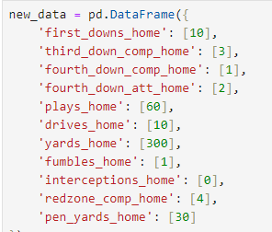
Predicting a Score
Inputted new data into Linear Regression to model an average NFL game
Results
Home: 30 points
Away: 27 Points
Notes:
David

Slide 7
Model Insights Home
Feature | Coefficient | Feature | Coefficient
first_downs_home | 0.65 | yards_home | 3.96
third_down_comp_home | 0.77 | fumbles_home | -1.81
fourth_down_comp_home | 2.40 | interceptions_home | -1.93
fourth_down_att_home | -1.68 | redzone_comp_home | 2.34
plays_home | -0.49 | pen_yards_home | -0.33
drives_home | 1.41
Notes:
David

Slide 8
Model Insights Away
Feature | Coefficient | Feature | Coefficient
first_downs_away | 0.52 | yards_away | 4.23
third_down_comp_away | 0.57 | fumbles_away | -1.51
fourth_down_comp_away | 2.10 | interceptions_away | -1.89
fourth_down_att_away | -1.71 | redzone_comp_away | 2.67
plays_away | -0.38 | pen_yards_away | -0.21
drives_away | 1.25
Notes:
David

Slide 9
Other Considerations
Original model idea was to predict team specific scores
Use NFL team as a model feature
Linear regression needed more data than the name of the team to predict accurate scores
Ex: Chiefs vs Patriots final score = 13605 to 13591
External factors not included in the data:
Weather
Stadium environment
Travel considerations
Rest between games
Bias officiating
Trying more variations of features
Trying different models
Notes:
Ben

